Slide 1
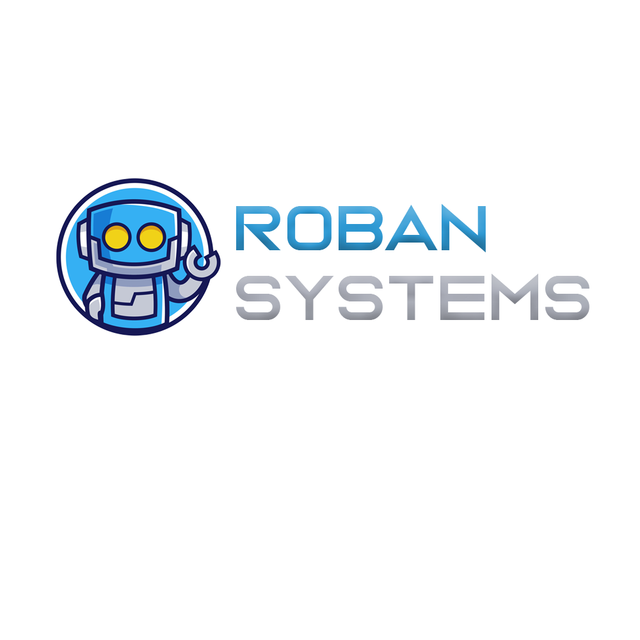

AN HELPING HAND FOR DISABLED PEOPLE

Slide 2




Our team
Ajay Das k
Fathima Irfana T P
Muhammed Fais M T
Rabeeh C
CCV19CS002
CCV19CS019
CCV19CS007
CCV19CS015
GROUP NUMBER : 6
GUIDE NAME : NASRIN JUMANA K T

Slide 3
Introduction Roban system is the way of setting up an Economic Environment to Help The Disabled people with help of modern IOT Technology. All human needs can be fulfilled using Roban System we use C++, modern IOT architecture and MQTT protocols to full fill the Roban System it is more Economical than human labour

Slide 4
2.Formulation Of Objectives
Economic
Very cheper than human labour.
A suitable companion for disabled people
Easy to maintain
Help disabled people to fullfill their Needs
Module wise architecture
Daily life applications
Large scale compactibility
Wide range of application,applicable to every physical needs
Can be connect infinite nodes and large scale application

Slide 5

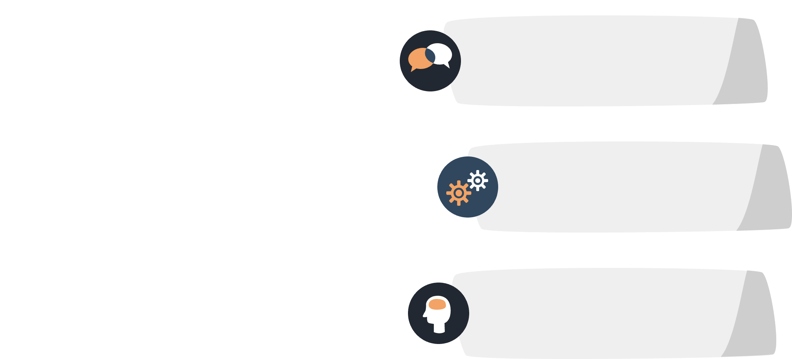

2.Project planning
Phase 1
Selecting topic,Conveying Idea,
Phase 2
First review,literature Survey
Phase 3
Making schematic,coding ,Implimentation
Phase 4
Documentation,Testing,Prototype,
Presentation

Slide 6
3. Task Identification And Allocation
Ajay Das k
Fathima Irfana T P
Muhammed Fais M T
Rabeeh C
Overall h/w
Fullfill needs
Security
Voice control
Overall connecting the modules and hardwares
Fullfilling the basic needs. Providing support to patients.
Security and surveillance to the patient and surrounding.
Controling all phyical objects using commands and guesters.

Slide 7
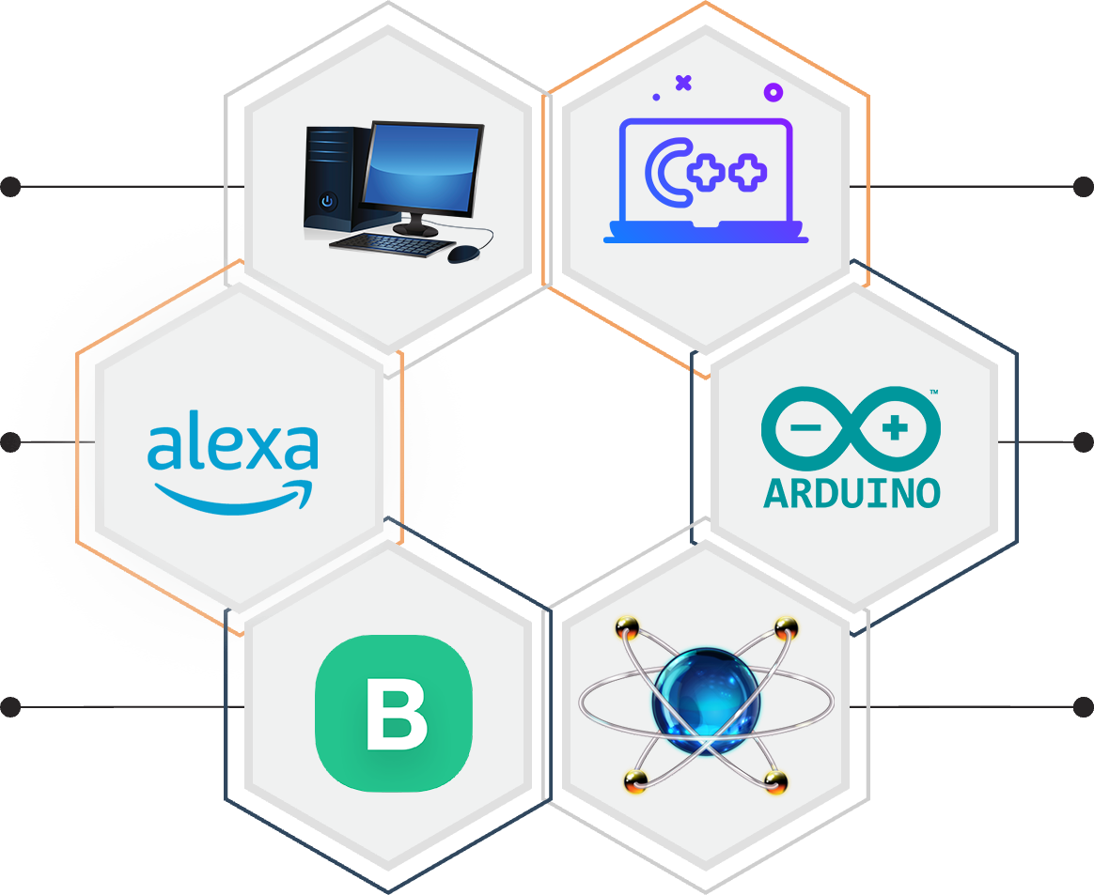
4.Requirments
Pc system
C++
Windows 7+,4 gb of Ram
C++ language is used for code
Alexa
Arduino ide
Amazon echodot speaker
To flash hende MCU and micro controllers
Blynk iot
Proteus
Blynk iot web server iot app
Circuit designing and testing

Slide 8
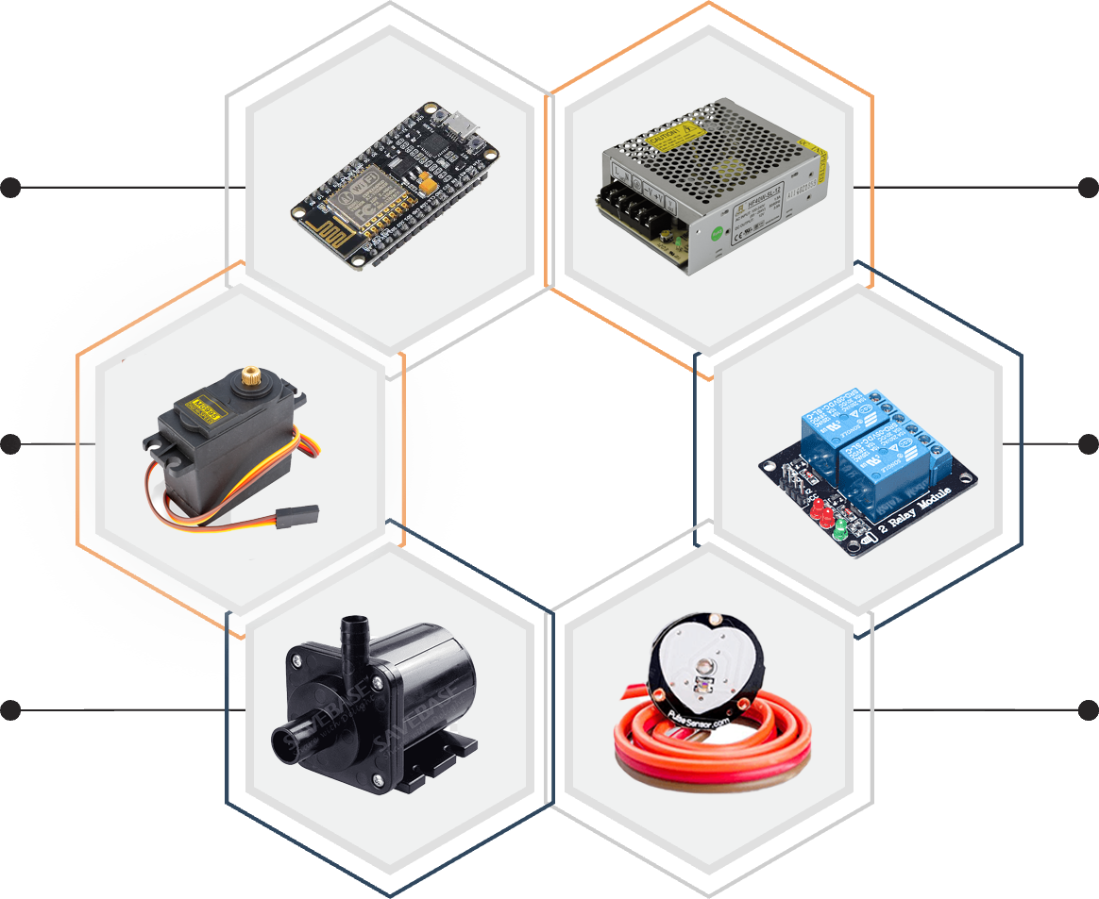
4.Requirments
Node MCU
S M P S
Micro controller bord with wifi
The power supply
Servo motor
Relay module
Used to lift and slide things
Used to trigger current flow
Pump/valve
Sensors
To controll liquid or air flow
Used to input the data

Slide 9
5.Architecture of Internet of Things (IoT)
These Sensors or Actuators accepts data(physical/environmental parameters), processes data and emits data over network.
Sensing Layer
Collecting data and aggregating data then converting analog data of sensors to digital data etc
Network Layer
Data processing Layer
Here data is analyzed and pre-processed before sending it to data center from where data is accessed by software applications often termed as business applications where data is monitored and managed and further actions are also prepared.
Application Layer
Data centers or cloud is management stage of data where data is managed and is used by end-user applications like agriculture, health care, aerospace, farming, defense, etc.

Slide 10
6. Formulation of Design
Code/conditions
sensors
Micro Controller
Server
Servo,Relay,Drivers
Real world

Slide 11

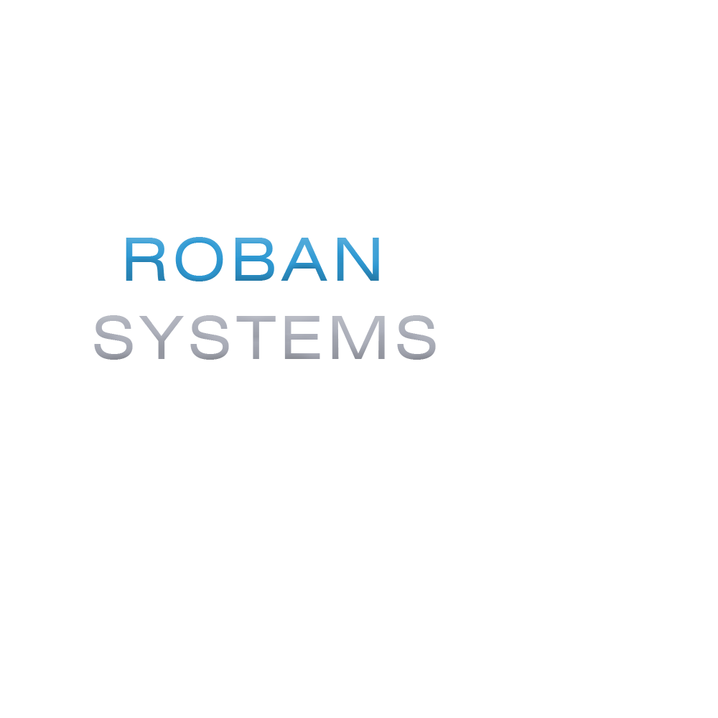
7. Modules
1
Bed and Ventilation
Module
2
Basic
Needs
Module
3
Security And Entertainment Module
4
Patient Monitor
Module

Slide 12
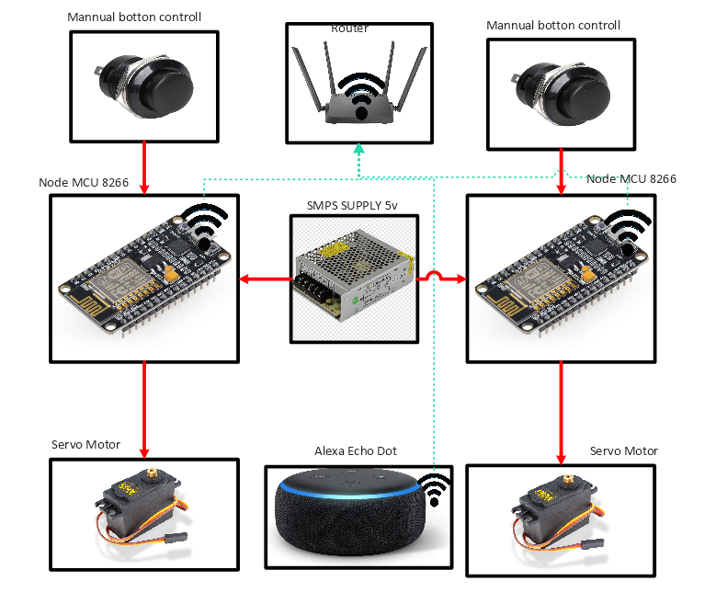
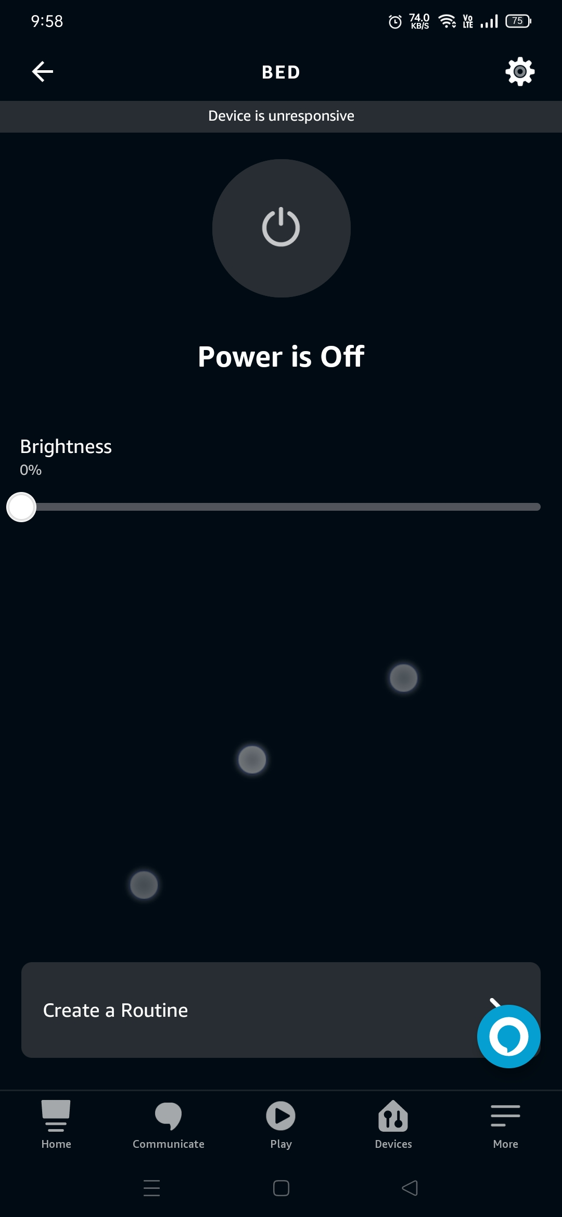
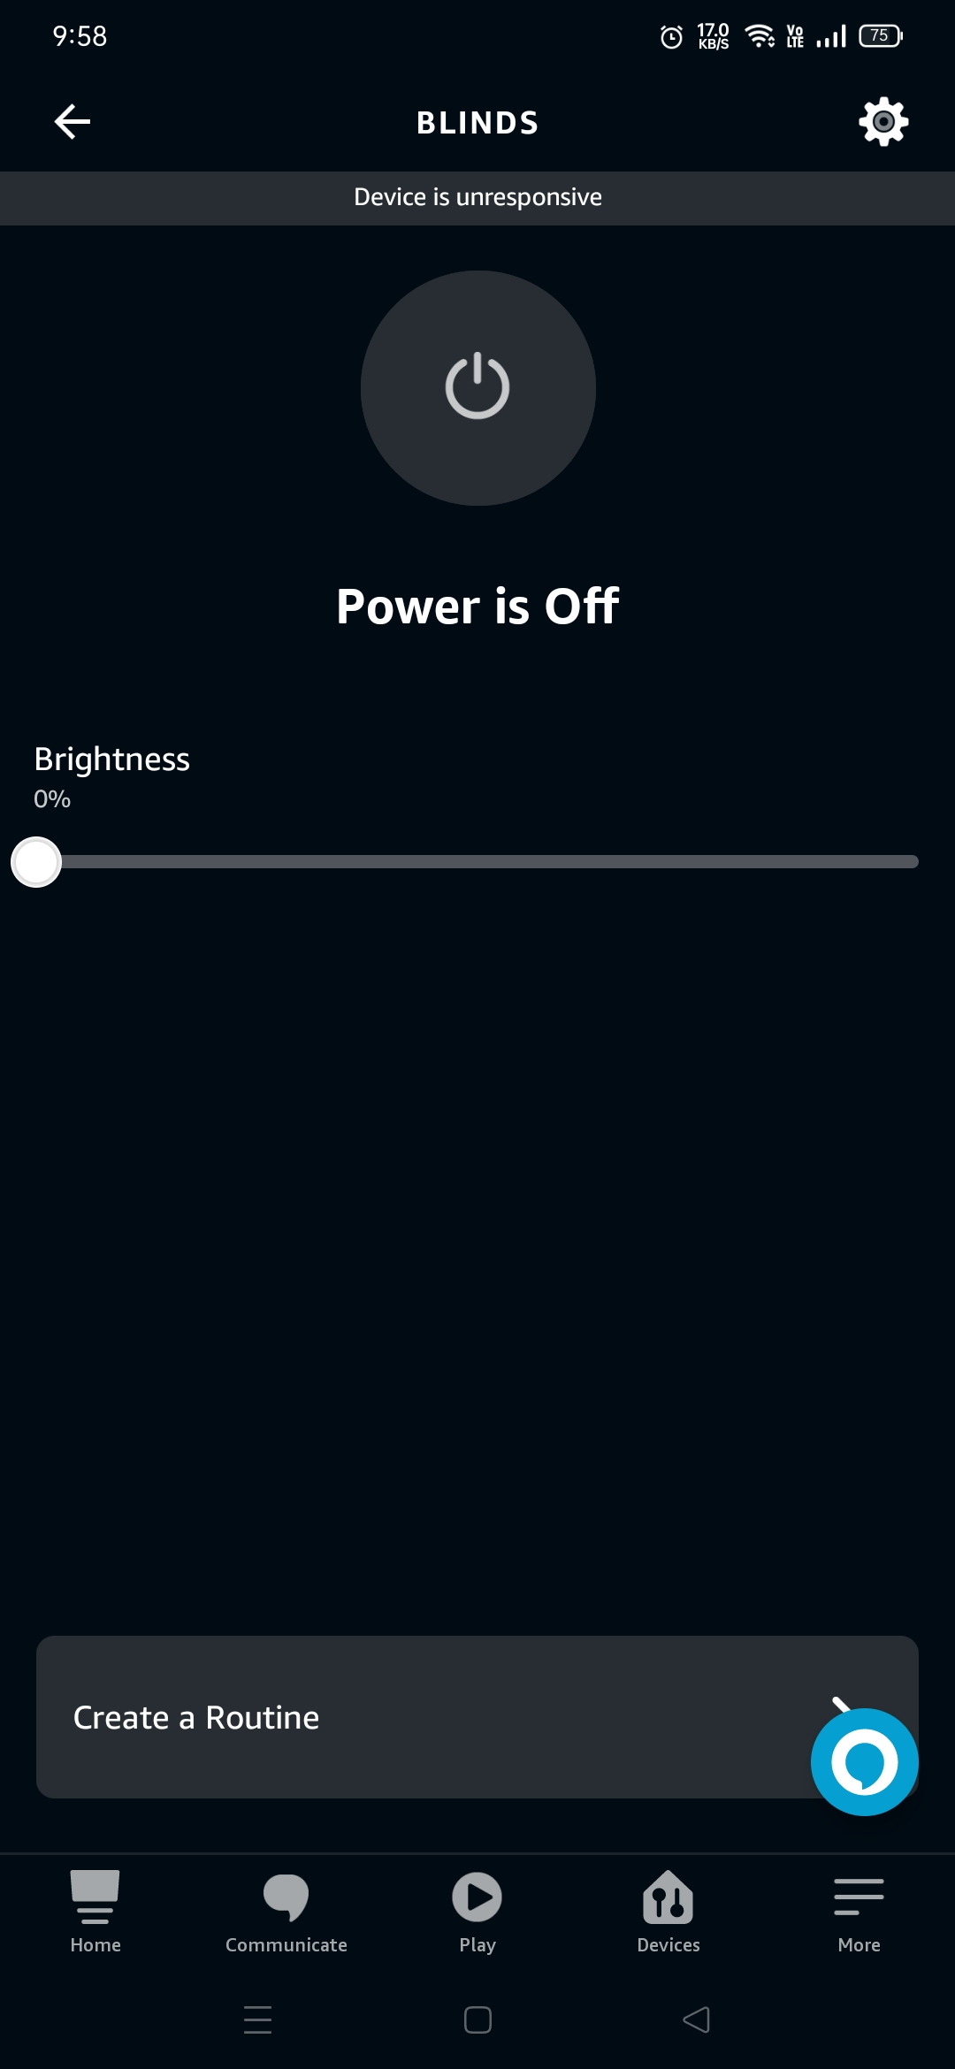
1.Bed And Ventilation Module
Control the angle of curtain/blinds.
Voice command enabled.
Easy to connect over the Internet.
Manual switches enabled.
Wide compatible with IOT platforms.
Application control is also available.

Slide 13
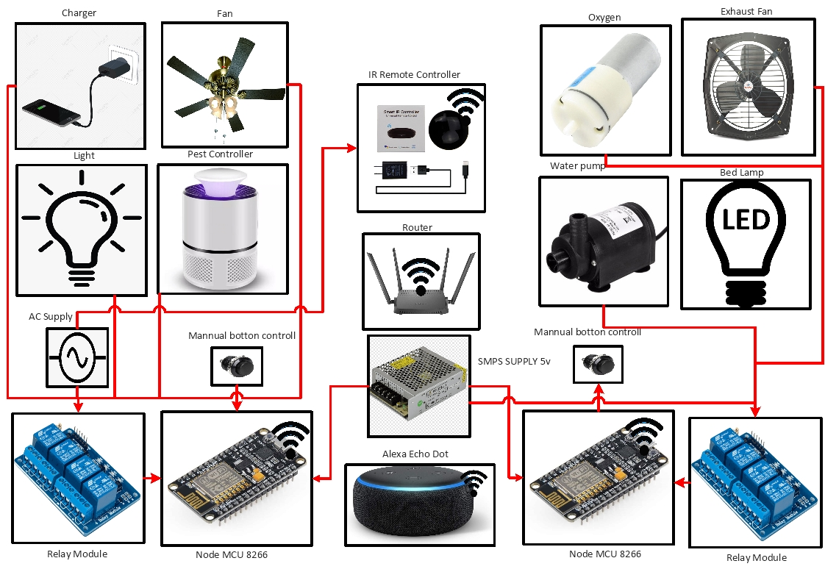
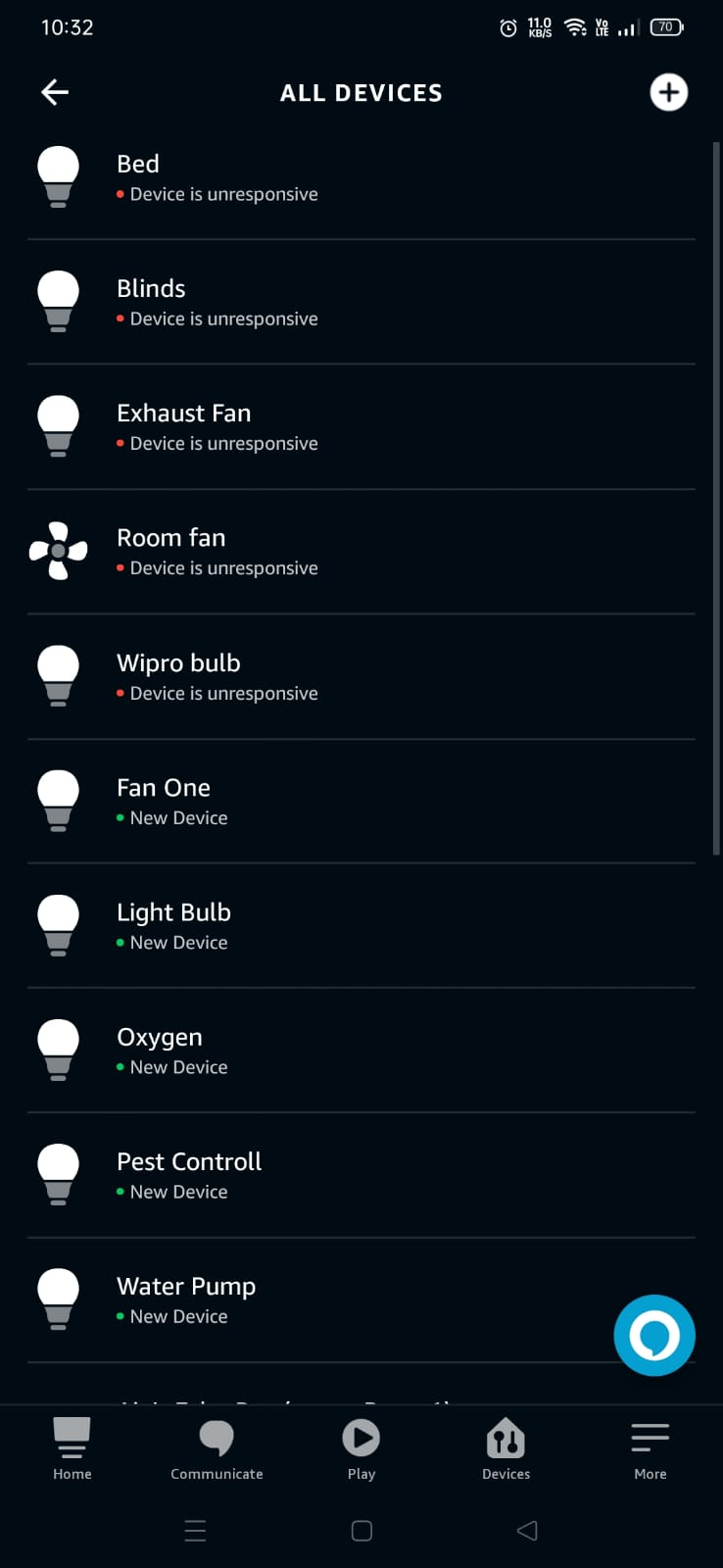
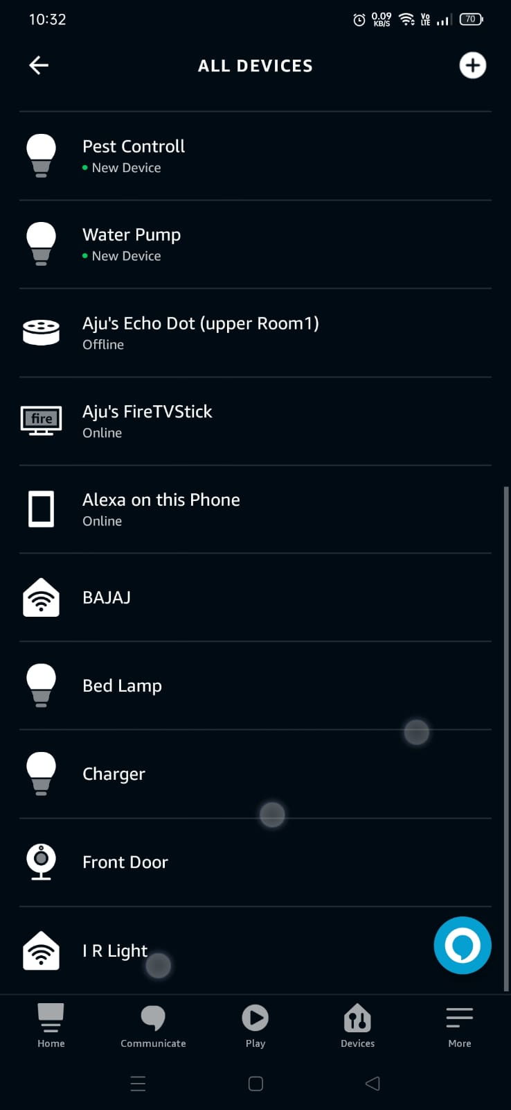
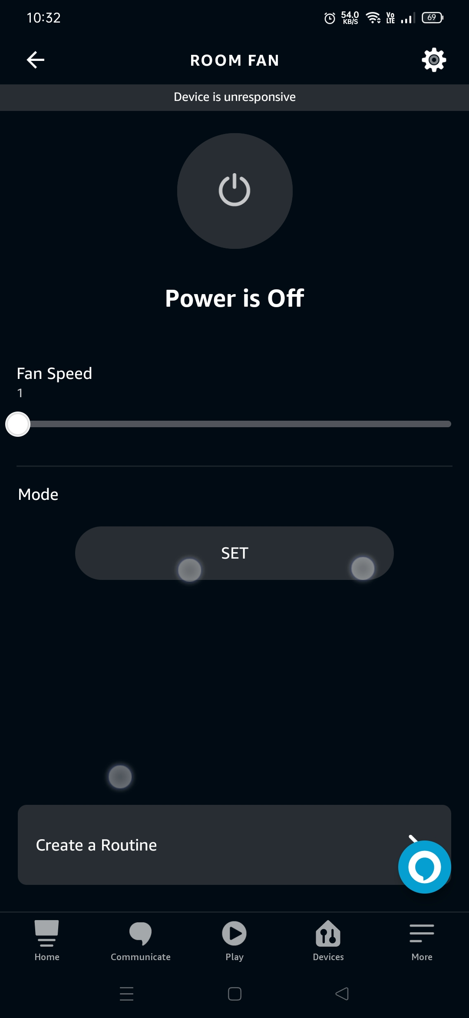
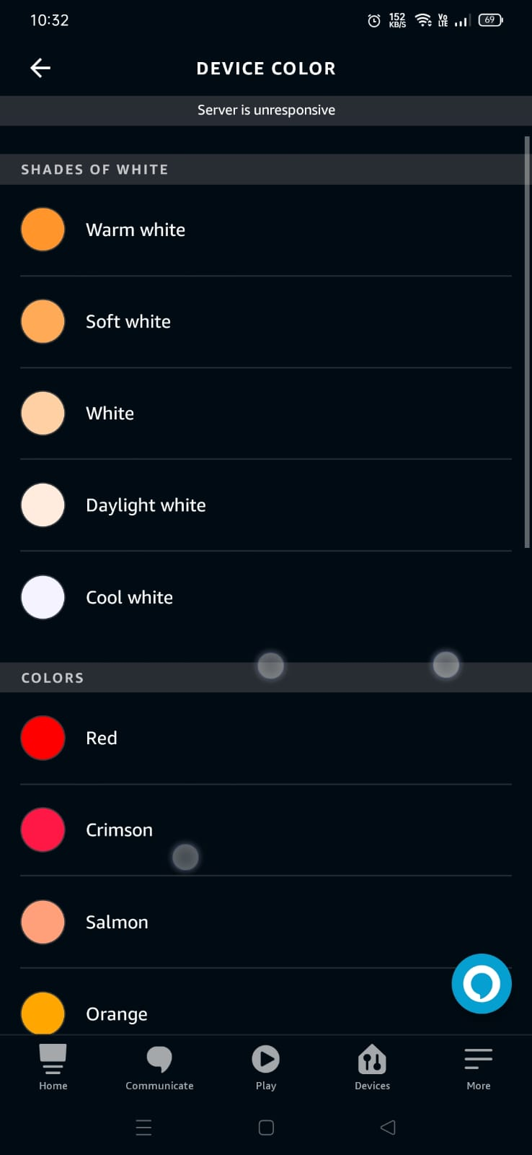
2.Basic Needs Module
Control the Daily life Appliances.
Voice command enabled.
Easy to connect over the Internet.
Manual switches enabled.
Infra red Controlled devices are also connected with IOT.
Wide compatible with IOT platforms.
Application control is also available.

Slide 14
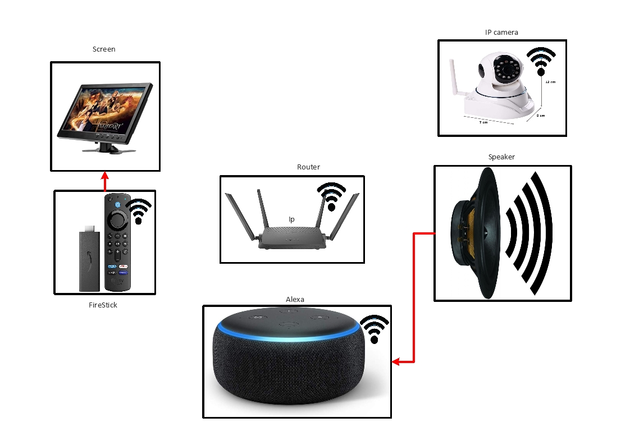
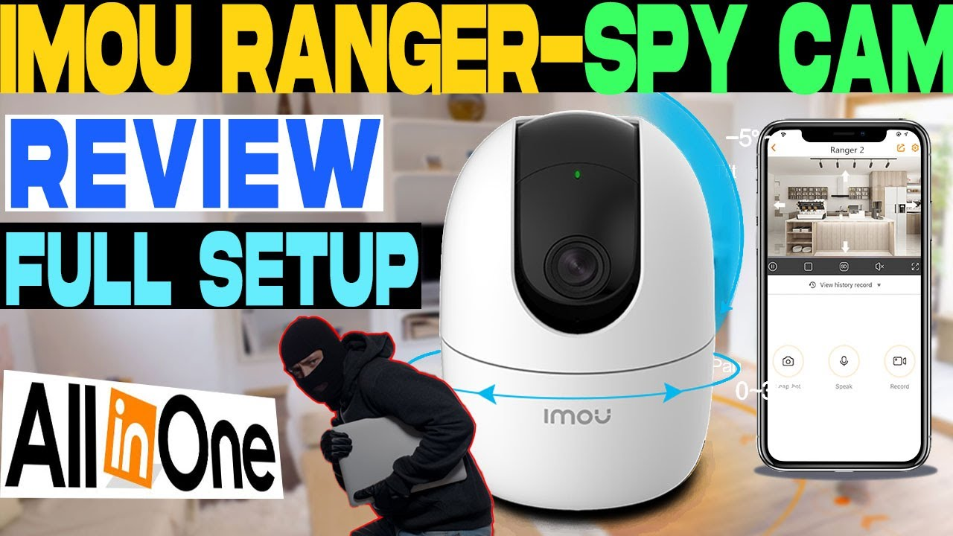
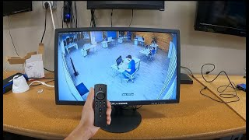
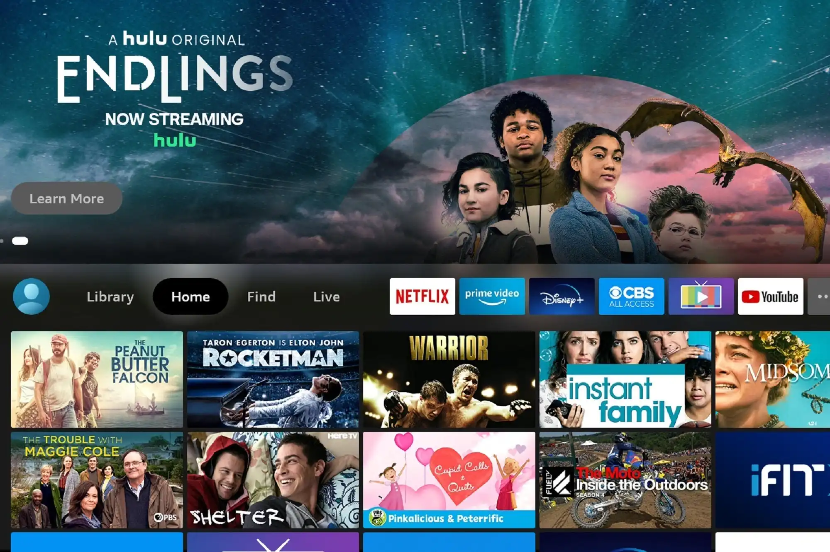
3. Security And Entertainment Module
Control the Daily life Appliances.
Voice command enabled.
Easy to connect over the Internet.
Entertainment And Monitor the premises.
Wide compatible with IOT platforms.
Remote Control Available.
Multiple Platforms.

Slide 15
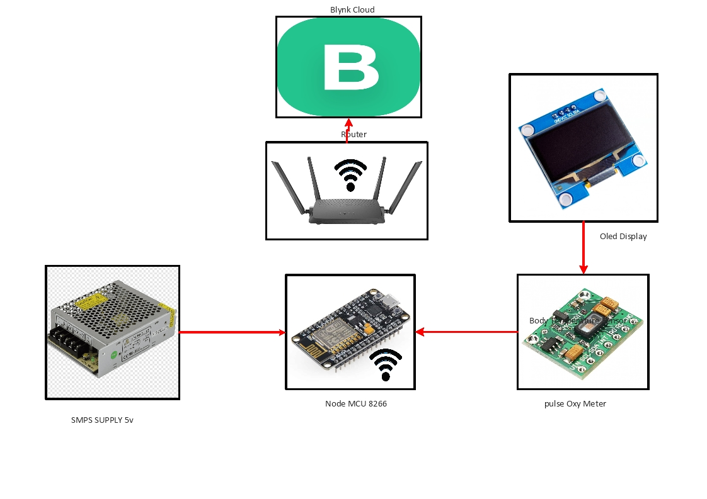
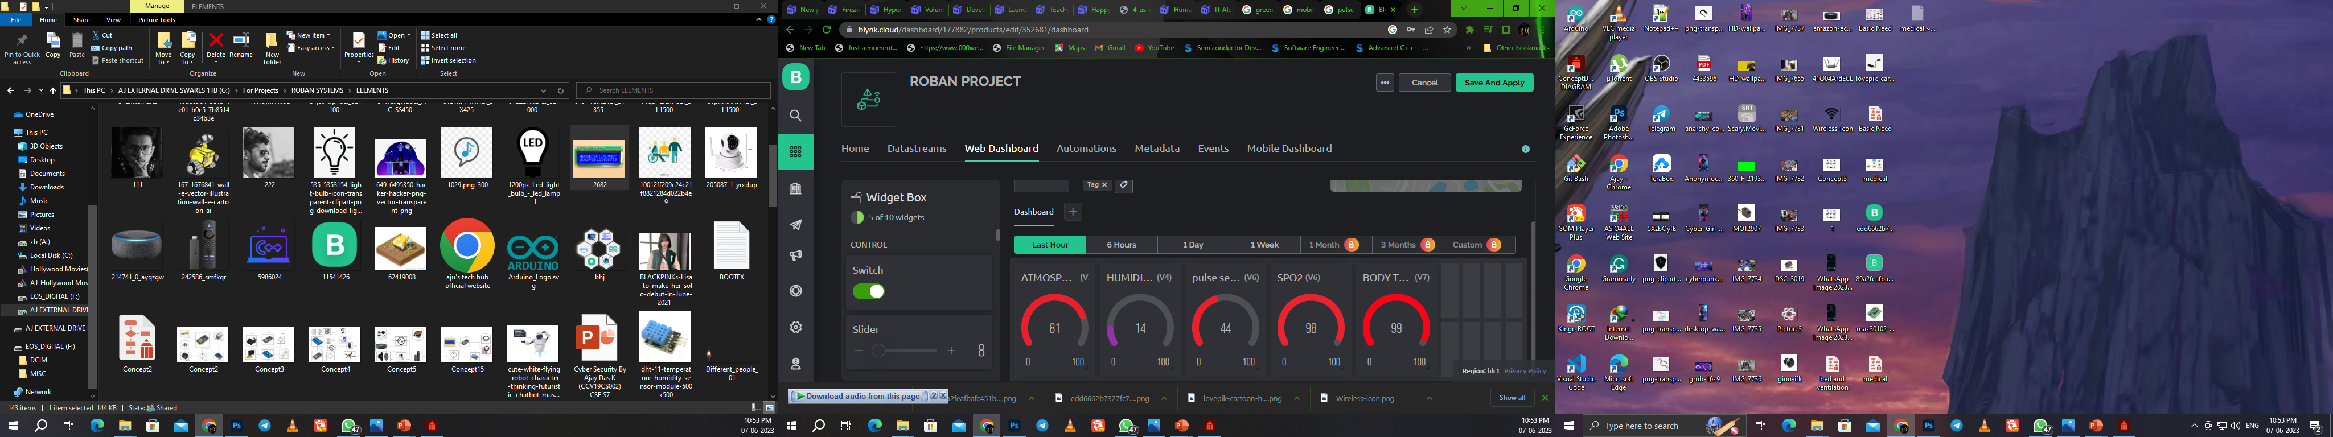
4.Patient Monitor Module
Monitor the patient anywhere around the world.
Easy to connect over the Internet.
Graphical charts and levels.
Automation And Triggering On Specific Conditions.

Slide 16
7. Project progress
Completed around 90% of the project
Implemented five modules (bed and ventilation, basic needs,
patient monitor module, medical aid module, security and monitoring)
Connected the modules with the IOT environment
Activated voice assistance with IoT devices
Calibrated sensors according to the environment

Slide 17
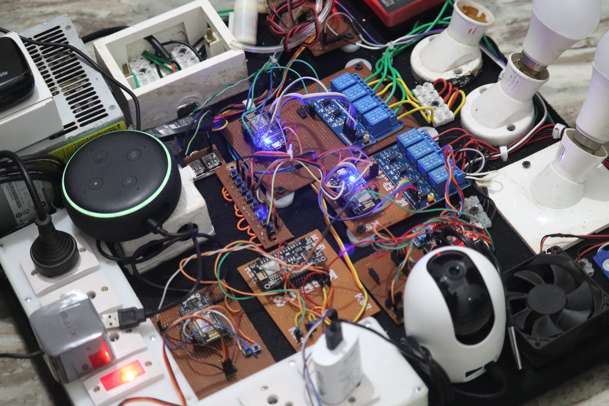
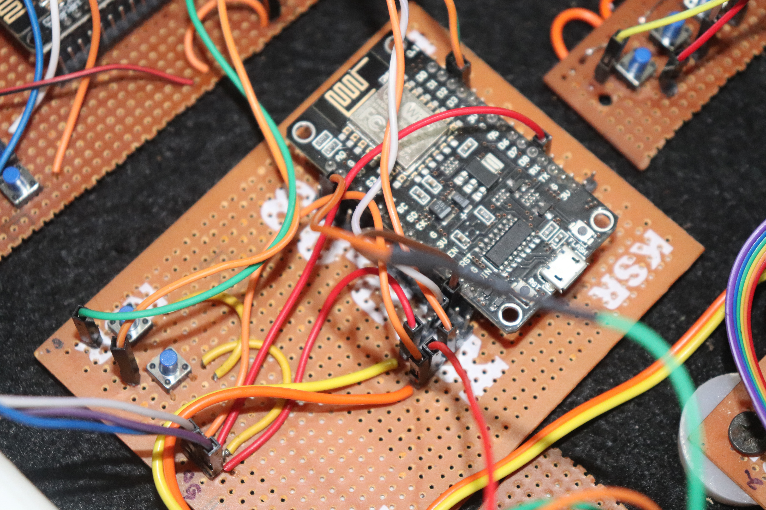
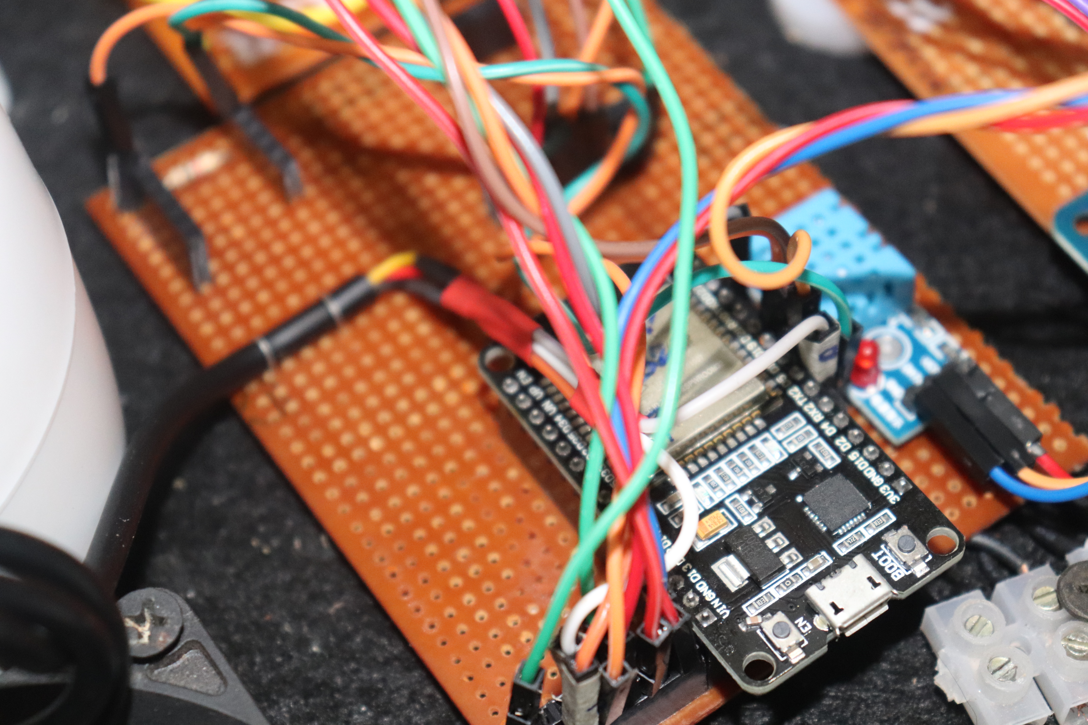
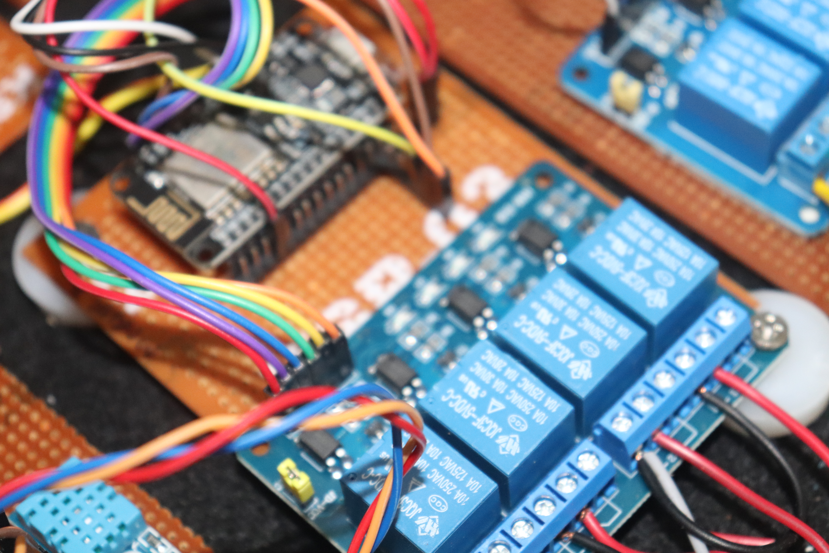
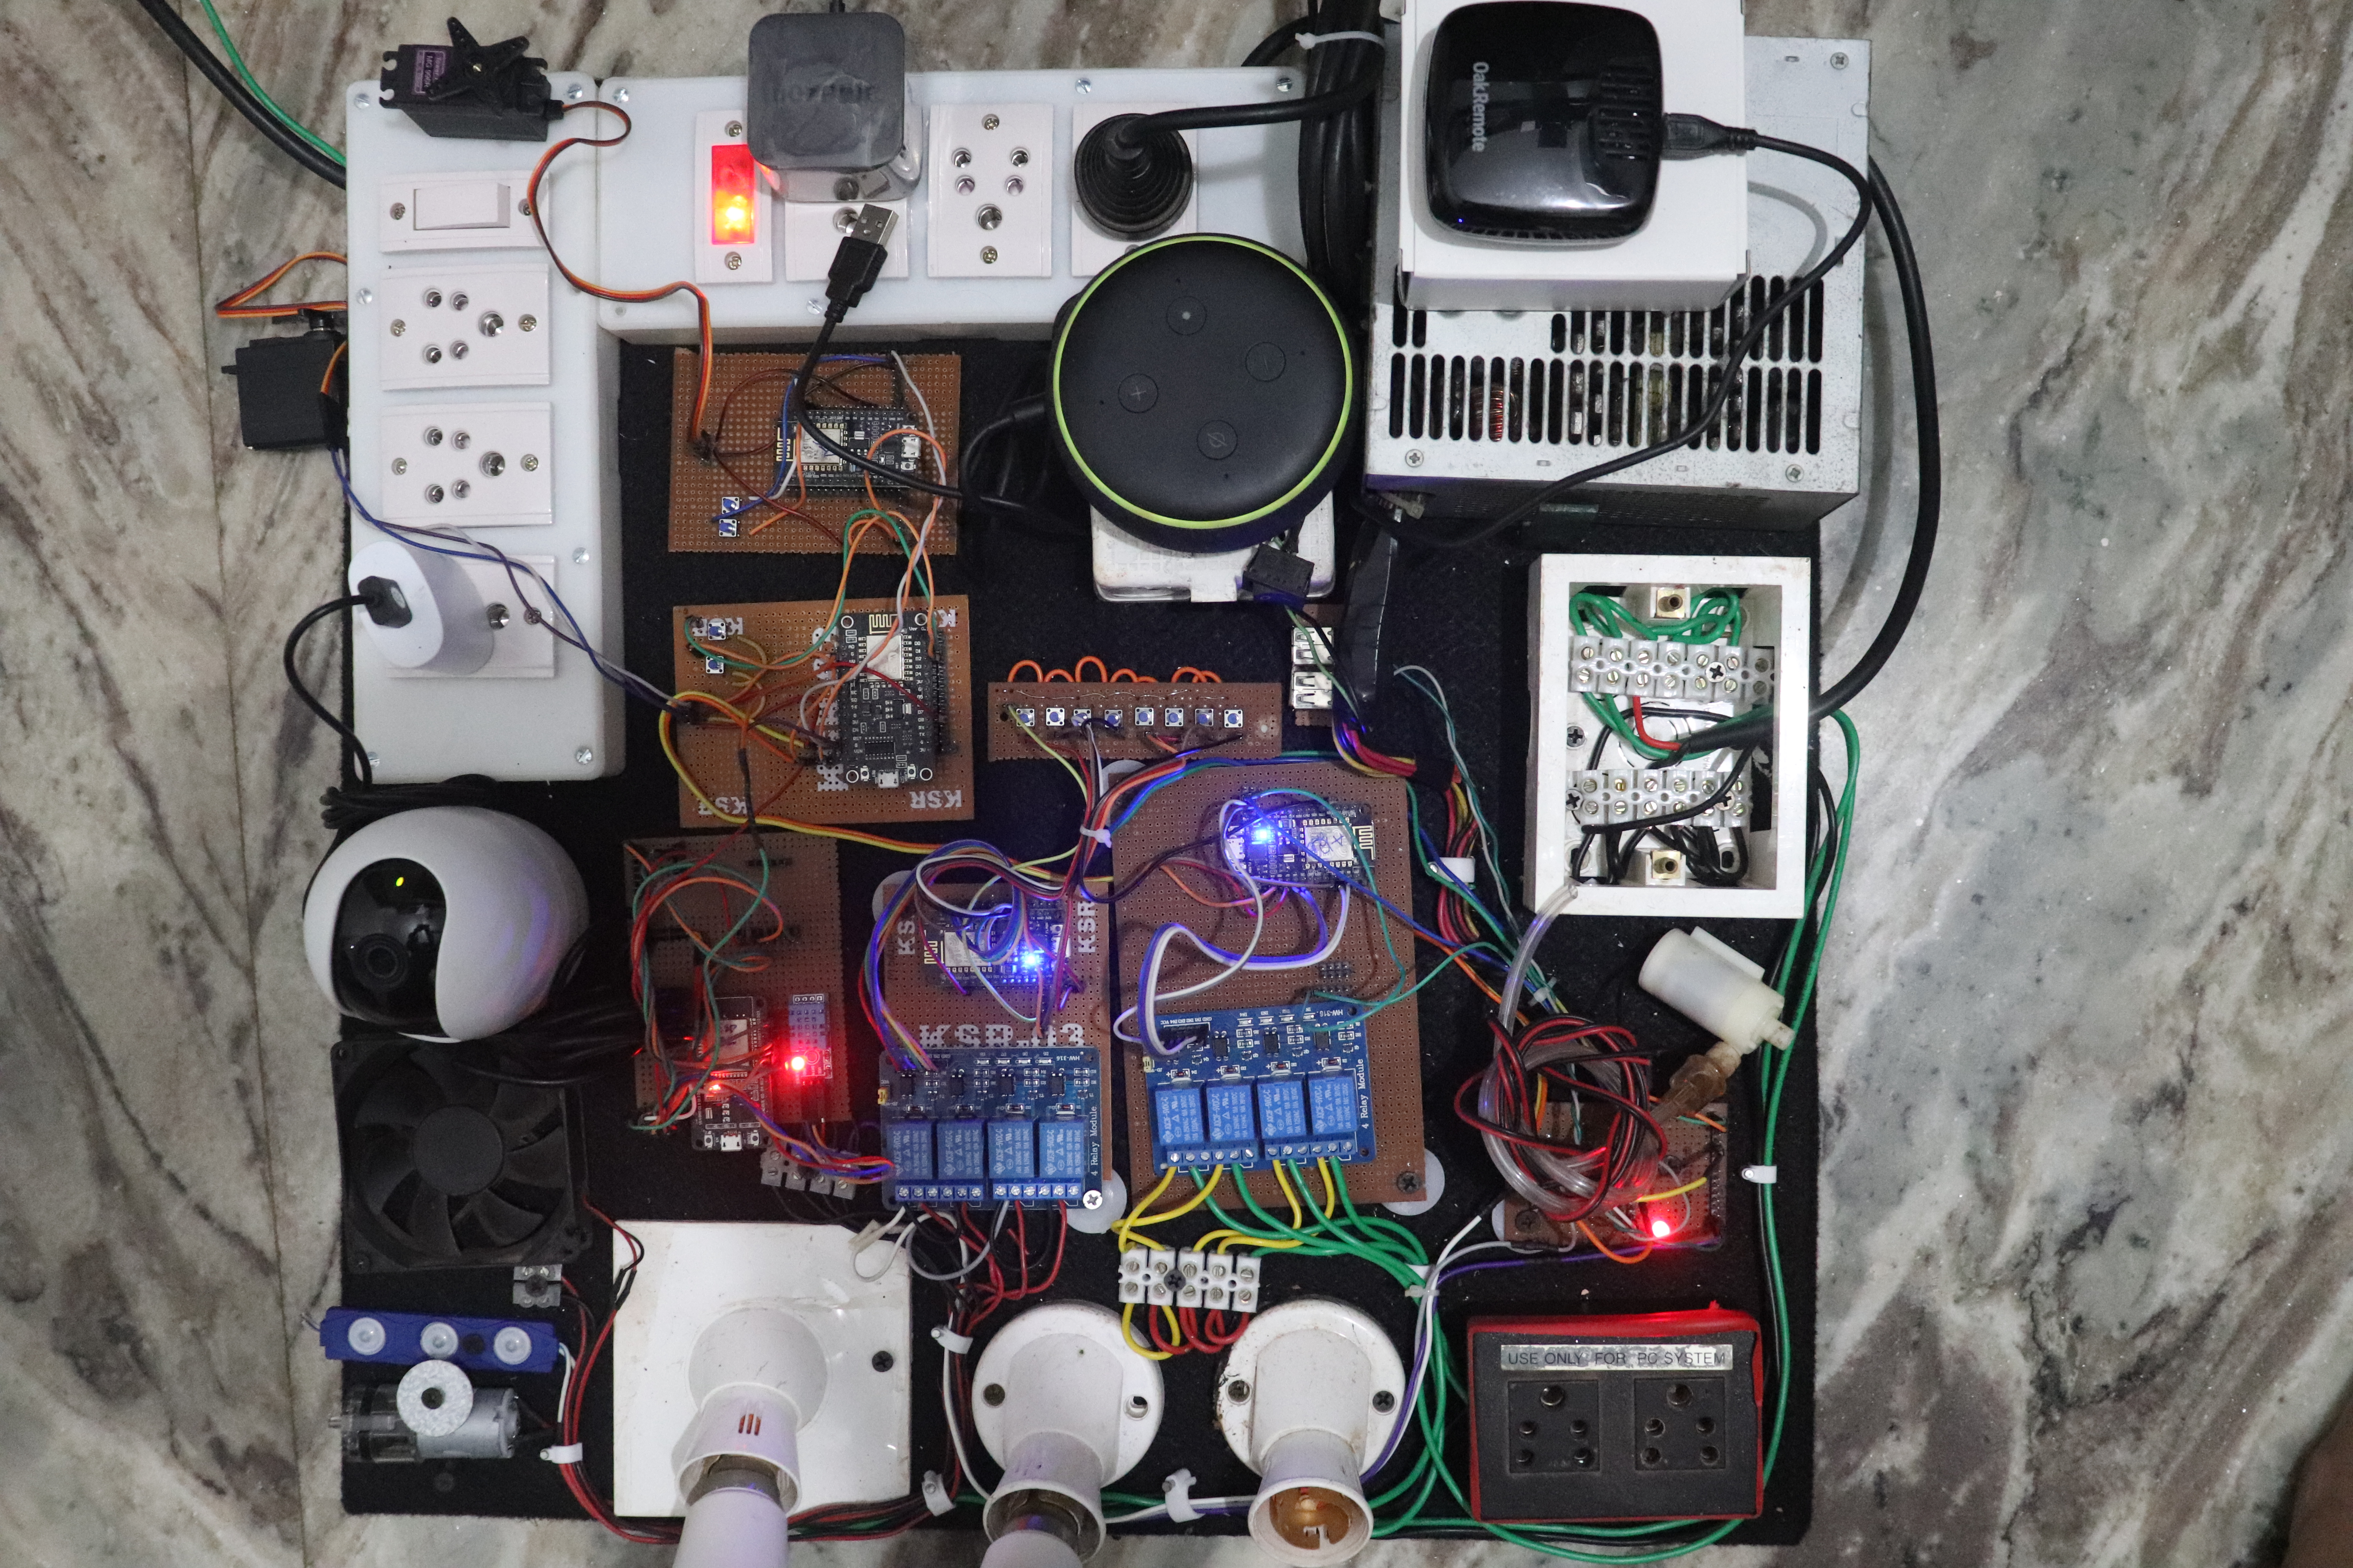
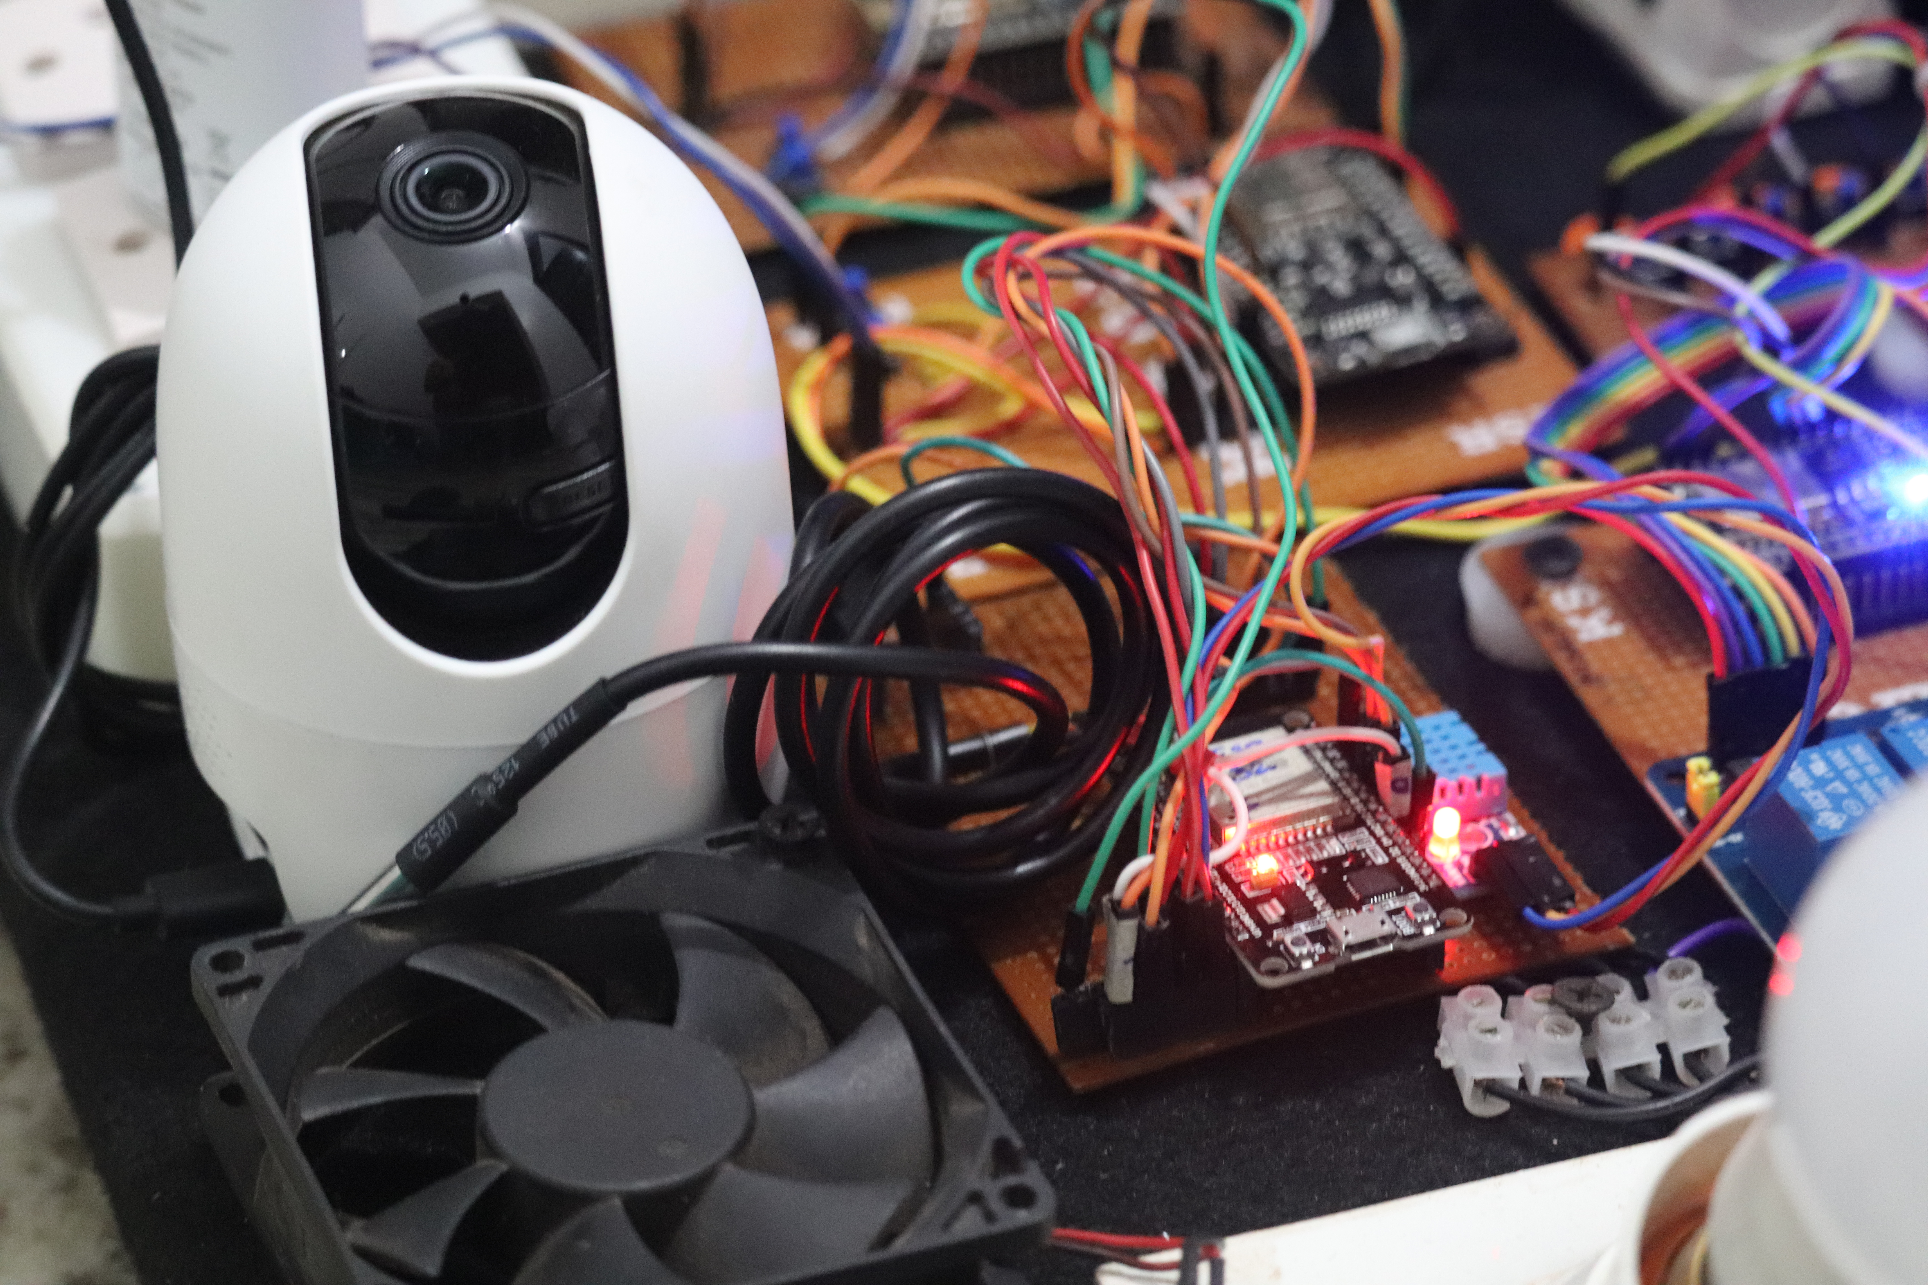
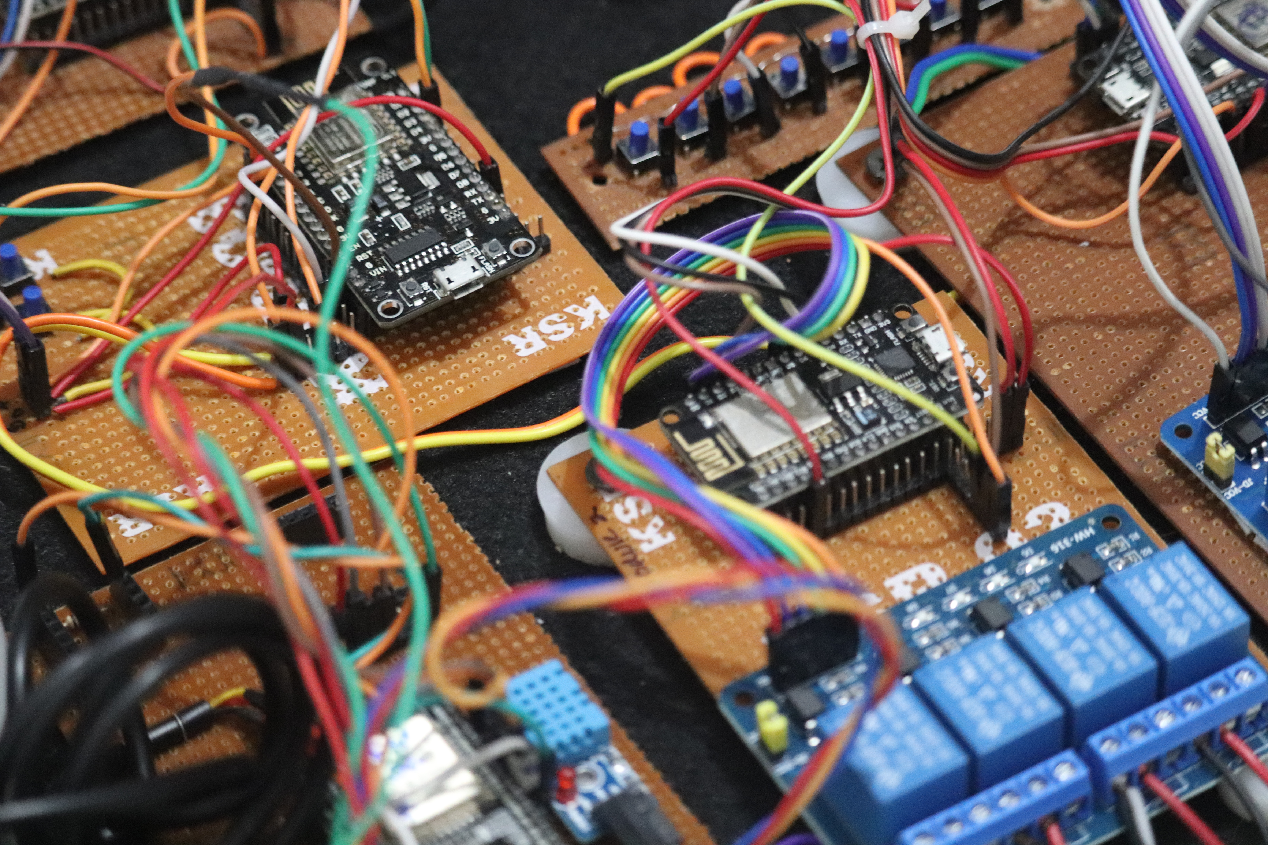
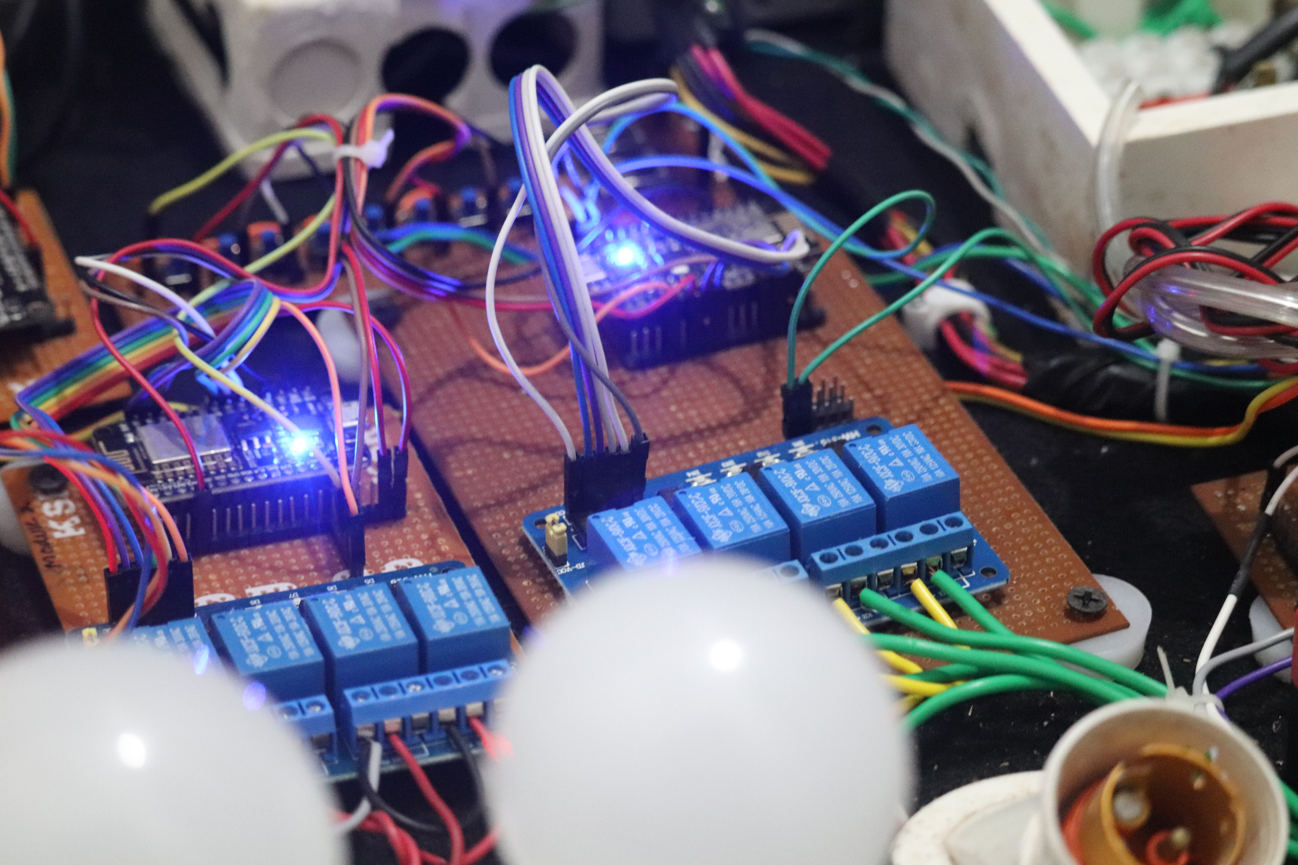
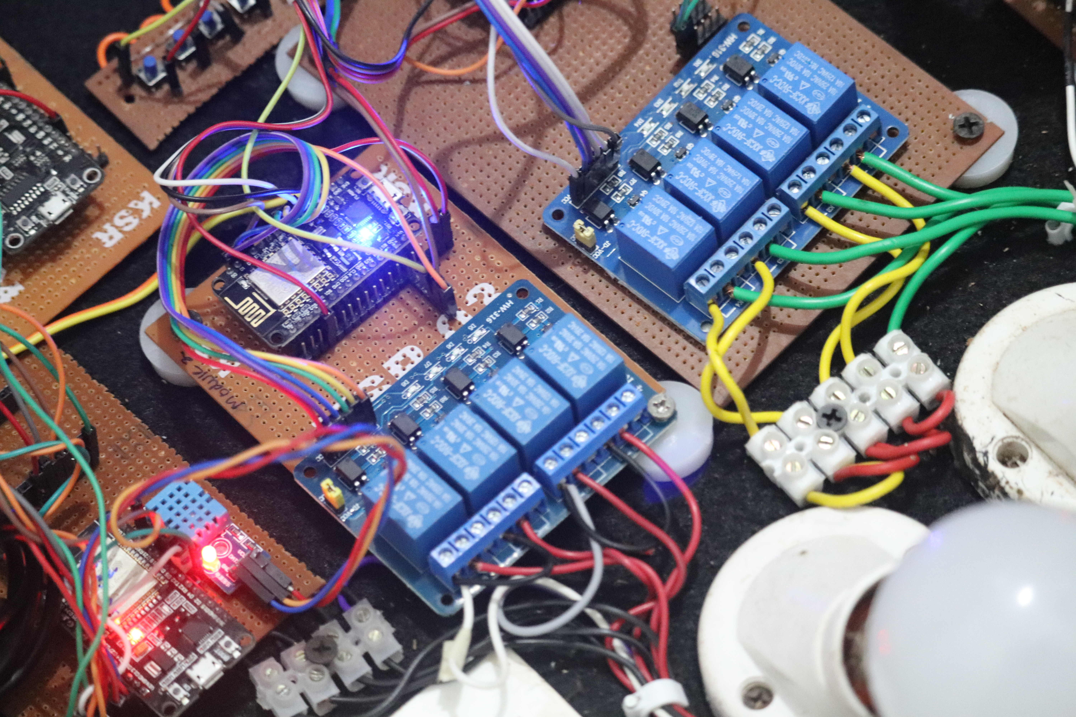

Slide 18
Reference
Git hub
Stack overflow
Knibus
Aurdino community

Slide 19
Thank you !
Any questions ?

